Slide 1
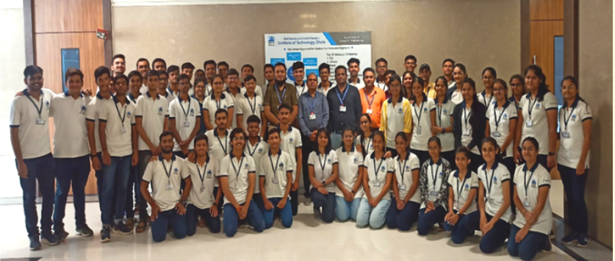
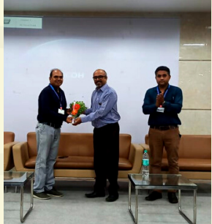
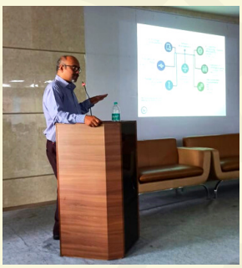
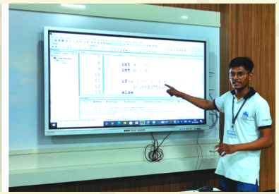
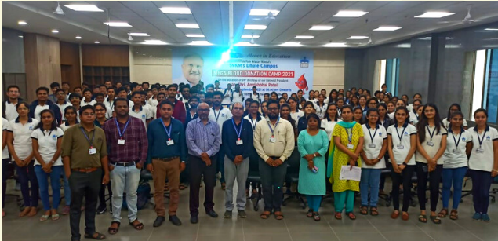
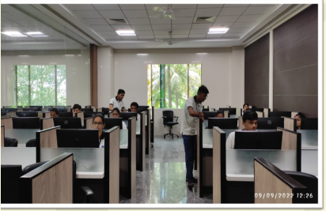
Student Development Program
Refresher Course On “C Programming”
Selected Activities Such As C Programming and GATE Awareness Program

Slide 2
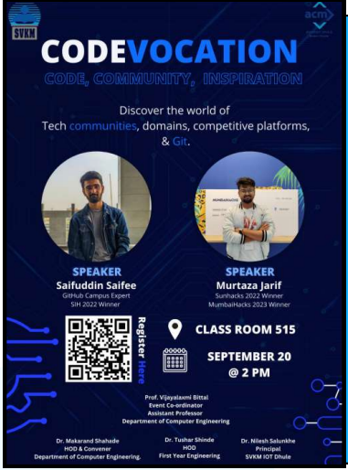
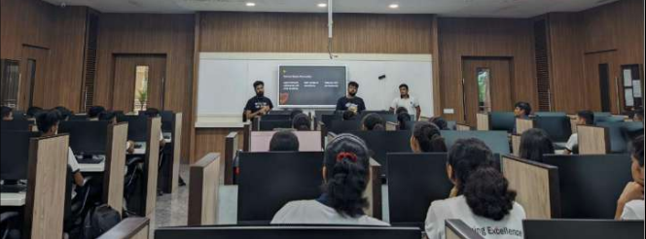
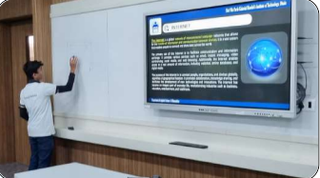
Student Development Program
Technical Activities for Students

Slide 3
Student Development Program
Department of Computer Engineering has Organized National Level
24 Hrs Hackathon

Slide 4
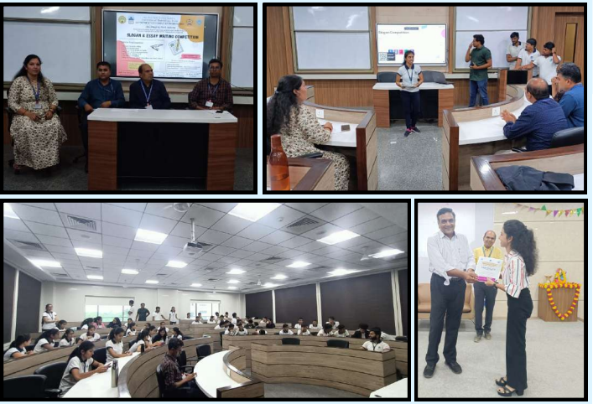
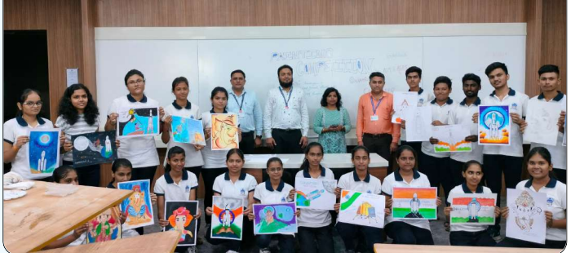
Student Development Program
Social Awareness Activity as Anti-Ragging Week Activity: Slogan and Essay Writing Competition
Drawing Competition

Slide 5
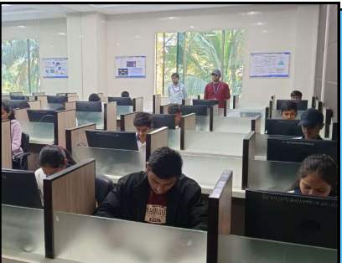
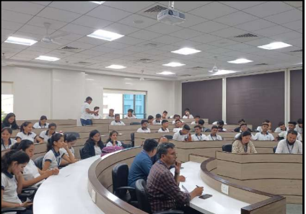
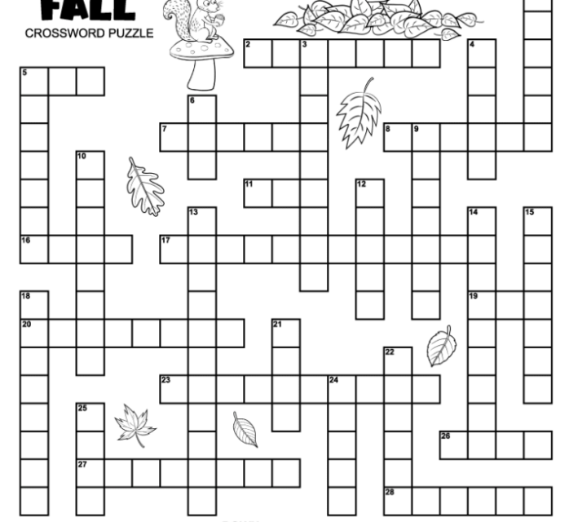
Student Development Program
Selective Activities as Crossword Puzzle and Vedic Maths

